Slide 1
ebay hunter
ebay Hunter
Sign in
Email or username
Password
Stay signed in
Sign in

Slide 2
ebay hunter
Welcome Back!
Add a Search Pattern
Number search patterns: 18
Last search run: Feb 12 2022 13:35:35
Previous search results: 38
Lifetime results found: 273
Delete or Modify a Pattern
Run a Search!
View Previous Results
Sign out
✅
Search pattern added X
❗️
Search pattern modified X
!
There are no saved search patterns X
!
Search pattern deleted X

Slide 3
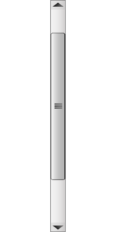
ebay hunter
Add a Search Pattern
Search keywords: Advanced search options
Exclude keywords:
In this category:
Search including:
Title and description Completed listings Sold listings
Show items priced from $ to $
Search keywords…
˯
All Categories
Add Pattern
Cancel

Slide 4
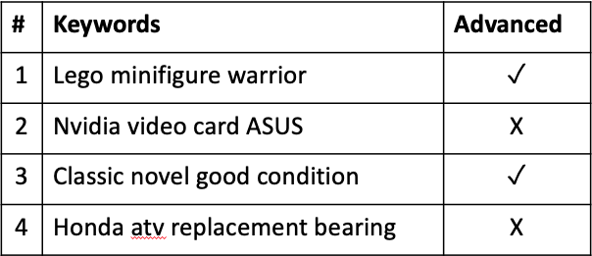
ebay hunter
Saved patterns
Modify
Modify
Modify
Modify
Go Back
# | Keywords | Advanced
1 | Lego minifigure warrior | ✓
2 | Nvidia video card ASUS | X
3 | Classic novel good condition | ✓
4 | Honda atv replacement bearing | X

Slide 5
ebay hunter
Modify Search Pattern
Search keywords: Advanced search options
Exclude keywords:
In this category:
Search including:
Title and description Completed listings Sold listings
Show items priced from $ to $
my existing search pattern
✓
˯
excluded keywords
Electronics
✓
Save Pattern
Delete Pattern
Discard Changes

Slide 6
ebay hunter
Searching in progress…
Patterns searched: 4/18
New results found: 14
Cancel

Slide 7
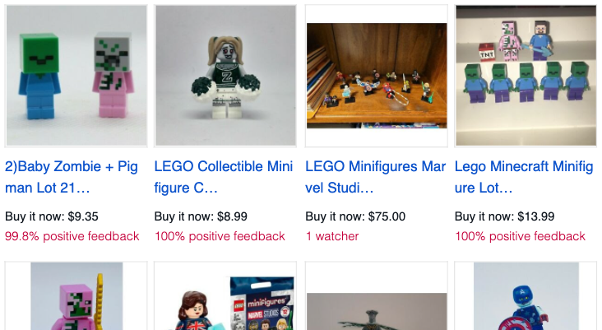
ebay hunter
28 New Search Results
Return to home screen

Slide 8
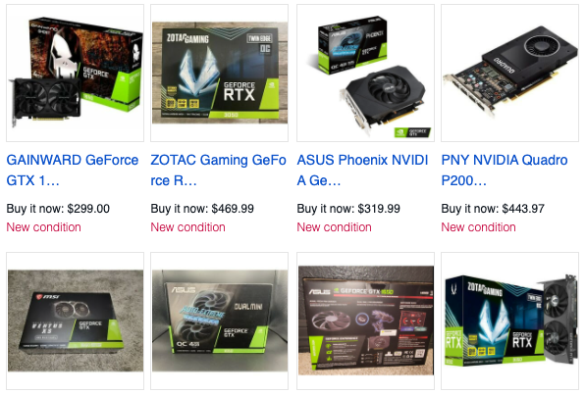
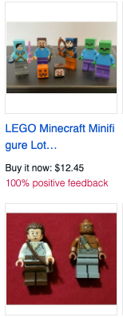
ebay hunter
301 Previous Search Results
Return to home screen

